Slide 1
Lesson Overview
Before You Go -2 min
Go over the 3 slides that tell them how to ready their models for the gallery walk– 5 min (just review, the last slide can stay up as they work)
Update model on MEME and link to evidence- 20 min.
Evidence discussion (if time permits)- if we see something in the simulation does this mean it must be in the pond? Discuss briefly. See what ideas they have. The aim here is to get them to argue, not necessarily to resolve this. However, theoretically one would need actual evidence (data) from the pond to show that the pond really behaves like simulations 8min
Total time- 35 mins

Slide 2
LESSON 1 - DAY 3
Notes:
Day 2 Outline
Goals-
- Decomposers use up air when eating dead matter (in this case dead algae)
- Decomposers grow and multiply
- Decomposers breathe air just like we do (dissolved air in water decreases)
Epistemic goals-
- Simulations can be used to test hypotheses.
- Evidence and simulations can be used together to develop and test hypotheses.
- If simulations do not fit the empirical evidence, their assumptions can be changed.
Carefully aligning evidence & simulations with models makes models better.
Materials
Computers- MEME and simulation
Student packet

Slide 3
BEFORE YOU GO
Answer the BEFORE YOU GO question at the end of your handout.
We have worked with simulations in this lesson.
How do you know if what a simulation shows is really what happens in a pond?
Notes:
Instruction
Students will answer the Before You Go on the last page of the packet. This is an exploratory question, to see what they know about how simulations are created and what they represent. Some students might say the sims do represent what happens and leave it at that. Other students might say they know because the sim was created to show a concept. Others might say we don’t know because it was created by someone. All answers are acceptable.
Collect packets at end of the lesson.

Slide 4
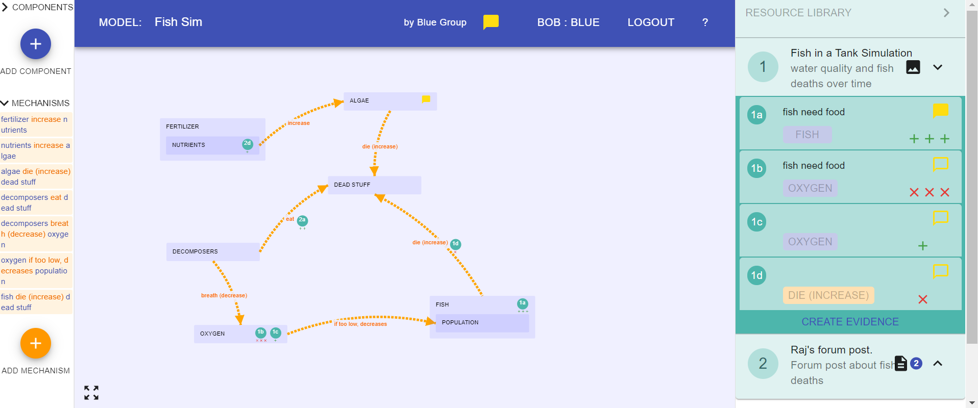

Getting Ready for the Gallery Walk!
Soon we will have a gallery walk and groups will be able to see and critique other groups’ models!
You have time today to prepare your model for the gallery walk:
Update model on MEME to include what we learned from ALL the evidence up to now.
Make sure you show how your model is supported by evidence (link the evidence to components and mechanisms).
Make sure your model meets the class criteria.
Notes:
Briefly explain aim for fixing the models (5min)== next two slides explain these points in a bit more detail so don’t spend too much time on this slide
Tell students that they will be doing a gallery walk soon and that during this event they will be able to see and comment on (critique) other group’ models.
They need to make their models the best they can be for this gallery walk.
Towards this aim they need to make sure their models are complete, have evidence to support components and mechanisms, and meet class criteria

Slide 5
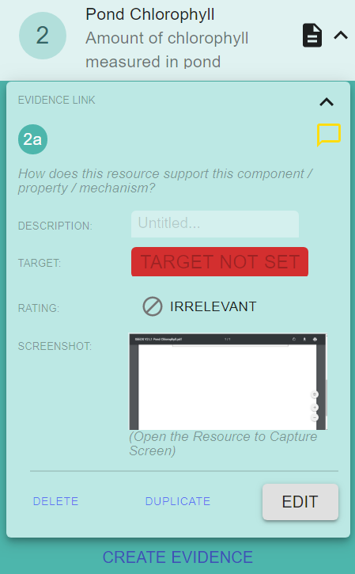
Getting Ready for the Gallery Walk
Go over each piece of evidence and decide:
Does it provide important information about why the fish died?
Should we add a component or mechanism based on this evidence? If yes- add them! You probably don’t need to change your entire model just the parts the need to be fixed
If you don’t need a piece of evidence you created you can delete it (see red box)
Notes:
Tell students that a good way to make sure their models are complete is to go over each resource and evidence and figure out if they provide information about a component or a mechanism that should be added to the model
Then they need to add new components and models. Or maybe modify part of a model
Remind them that they can also delete evidence

Slide 6
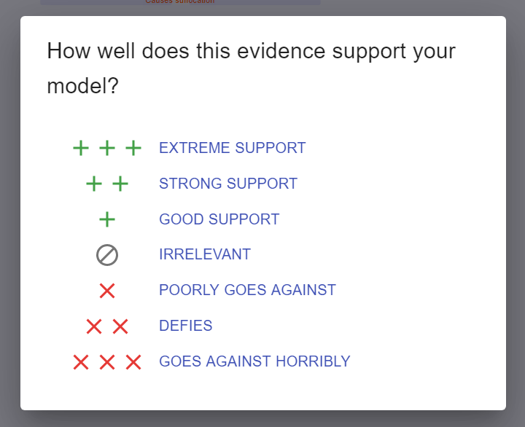
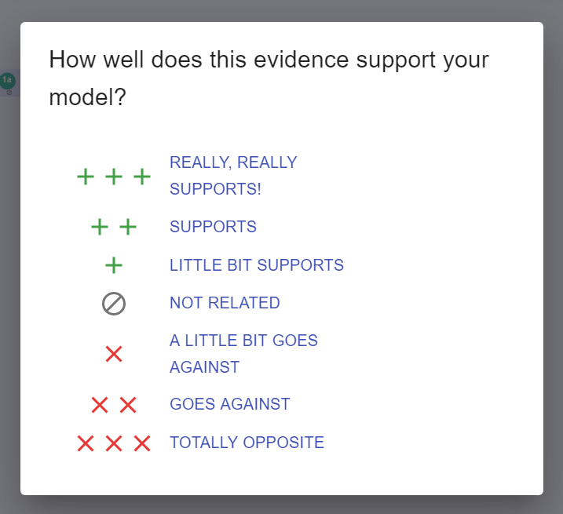
Getting Ready for the Gallery Walk
Now check your model:
Did you describe the components and mechanisms?
Are your components and mechanisms supported by evidence?
NOTE: you can link evidence to components or mechanisms!
Does your model completely explain why the fish died- the whole story?
Does your model meet the class criteria?
5A
5B
Notes:
Remind students to describe components and mechanism and provide support for them. They should use the ++ and XX to show how the evidence relates to the models
They should make sure their model explains everything about why the fish died
The model should also meet the class criteria (these should be up and visible in the class).

Slide 7
Getting Ready for the Gallery Walk
Go over each piece of evidence and decide:
Does it provide important information about why the fish died?
Should we add a component or mechanism based on this evidence? If yes- add them!
If you don’t need a piece of evidence that you created, you can delete it.
Now check your model:
Did you describe the components and mechanisms?
Are your components and mechanisms supported by evidence? Link evidence!
Does your model completely explain why the fish died- the whole story?
Does your model meet the class criteria?
Notes:
Leave this slide up as they work

Slide 8

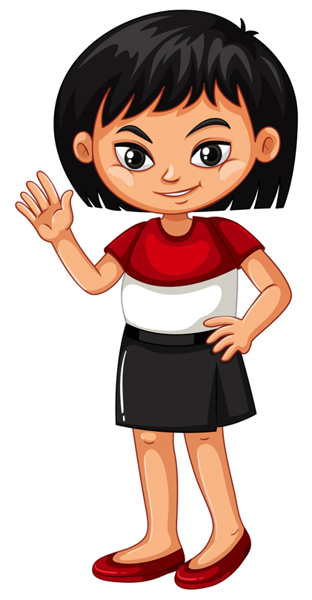
Evidence Discussion
Do you agree or disagree?
We can see there are decomposers in the simulation, so this means there must be decomposers in the pond…
Notes:
If time permits have a 5 min discussion of this question and then have students write their own answers on a sticky notes.
Instructions
IF THERE IS TIME: Have a class discussion about whether seeing decomposers in the simulation means that there must be decomposers in the pond.

Slide 9
MEME Tutorial
Reminder

Slide 10
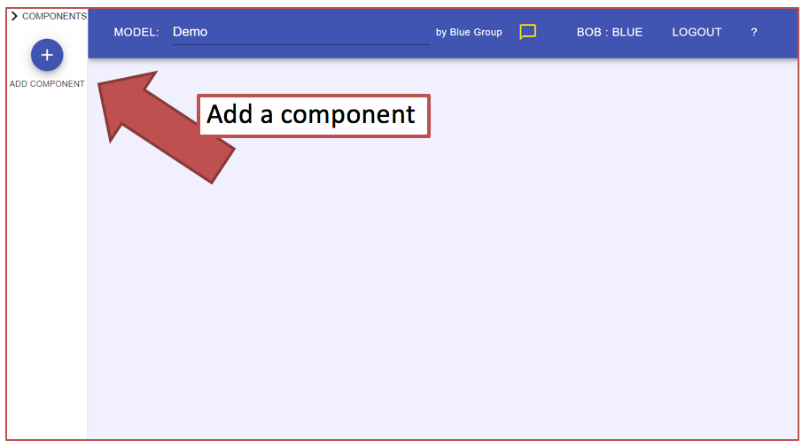
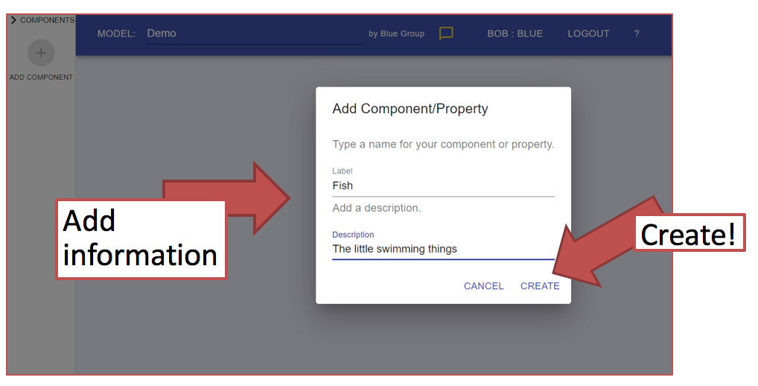
MEME: Review
To add a component click on the purple + button:
Type the name of component and click create:
Notes:
Instruction
Remind students how to add a component by clicking on the purple button and typing the name of the component. Here would be a good time to talk about describing components. For example, for decomposers they can add microscopic here as a detail.

Slide 11
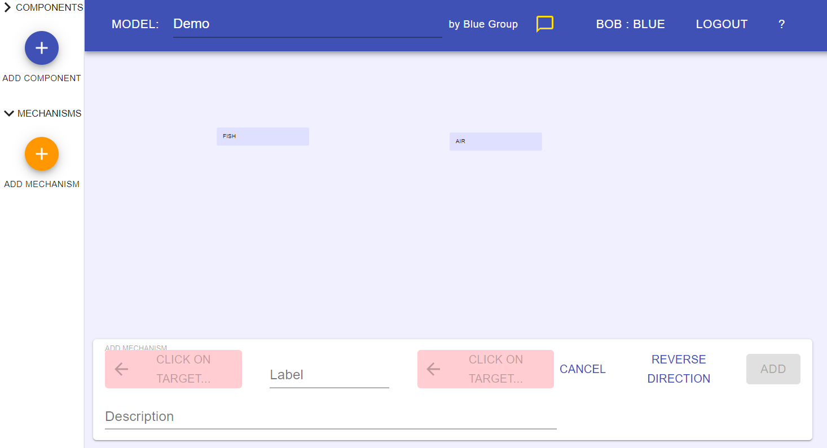
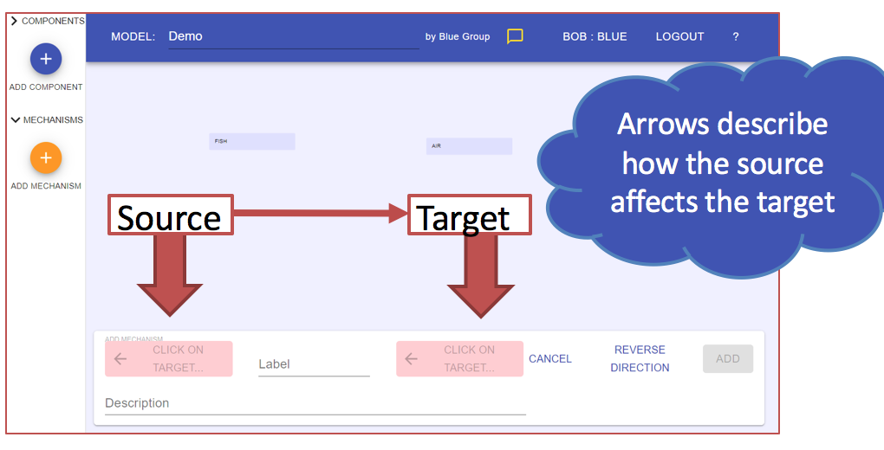
MEME: Review
To add a mechanism, click on the orange + button:
Then select target (where mechanism going from and to) and label the mechanism.
Notes:
Instruction
To add a mechanism: click on the orange + button. Then type in target (where arrow going from) and to(where arrow going to) Add descriptor to the line/mechanism. Click ok.
Reminder- students can move components and mechanisms around by clicking and holding on the icon and moving it about. They can also delete it by clicking on the component or mechanism then clicking delete at the bottom of the page. They can also change one by clicking on the component or mechanism then clicking edit at the bottom of the page.

Slide 12
MEME: Link Evidence
Now, let’s look at how we can make our model stronger by linking evidence to the components and mechanisms.
See next slide for instructions...
Notes:
Instruction
Remind students that they can make their model stronger by linking it with evidence. This makes the model stronger by showing directly how it is supported and where that support comes from. Briefly remind students about how we talked about how evidence is important and helps us learn. This is one way we can directly use evidence to help us learn, by linking it to the model.
Things to consider- The students might have trouble following along step by step so make sure to do each step one at a time and make sure they are all with you. The rest of the team will be on hand to trouble shoot as we go through each step. Also, this step will make more sense to students if they are on board with why evidence is important, so recapping that point before linking the evidence will help them to see the purpose for this step.

Slide 13
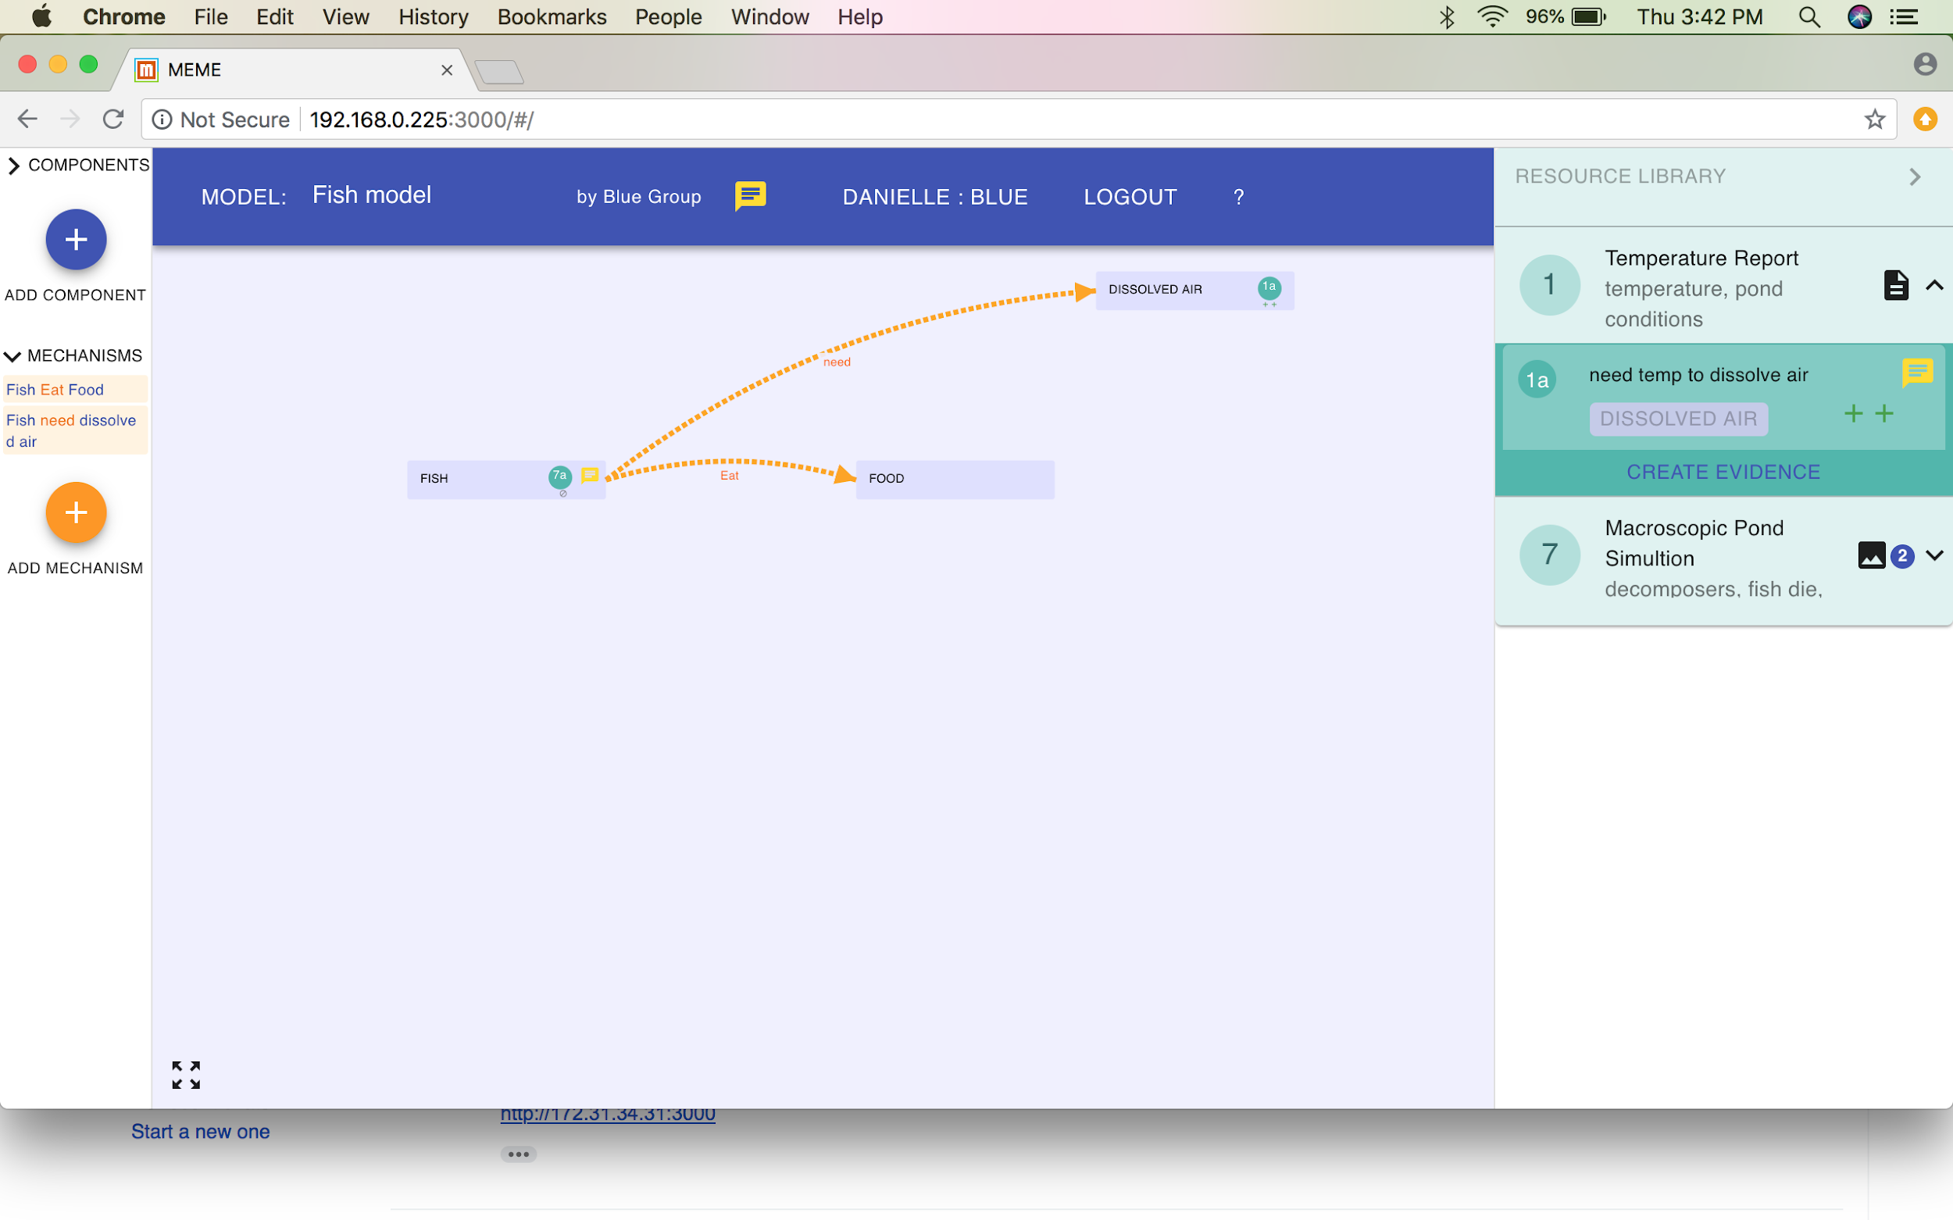
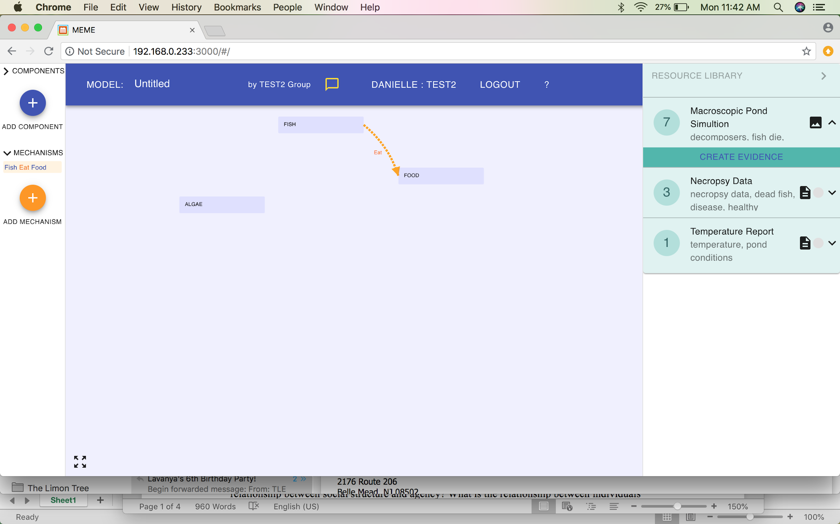
MEME: Link Evidence
Step 1: Click on the
resource
(green box) that you
want to add evidence
to
Step 2: Click on create evidence
Notes:
Instruction
Step 1- Identify the resource that they want to add evidence to. For example, they might want to add evidence to a piece of evidence they studied in stations yesterday or a simulation they worked with.
Step 2- click on “create evidence” in the dark green box that is below the green resource box.

Slide 14
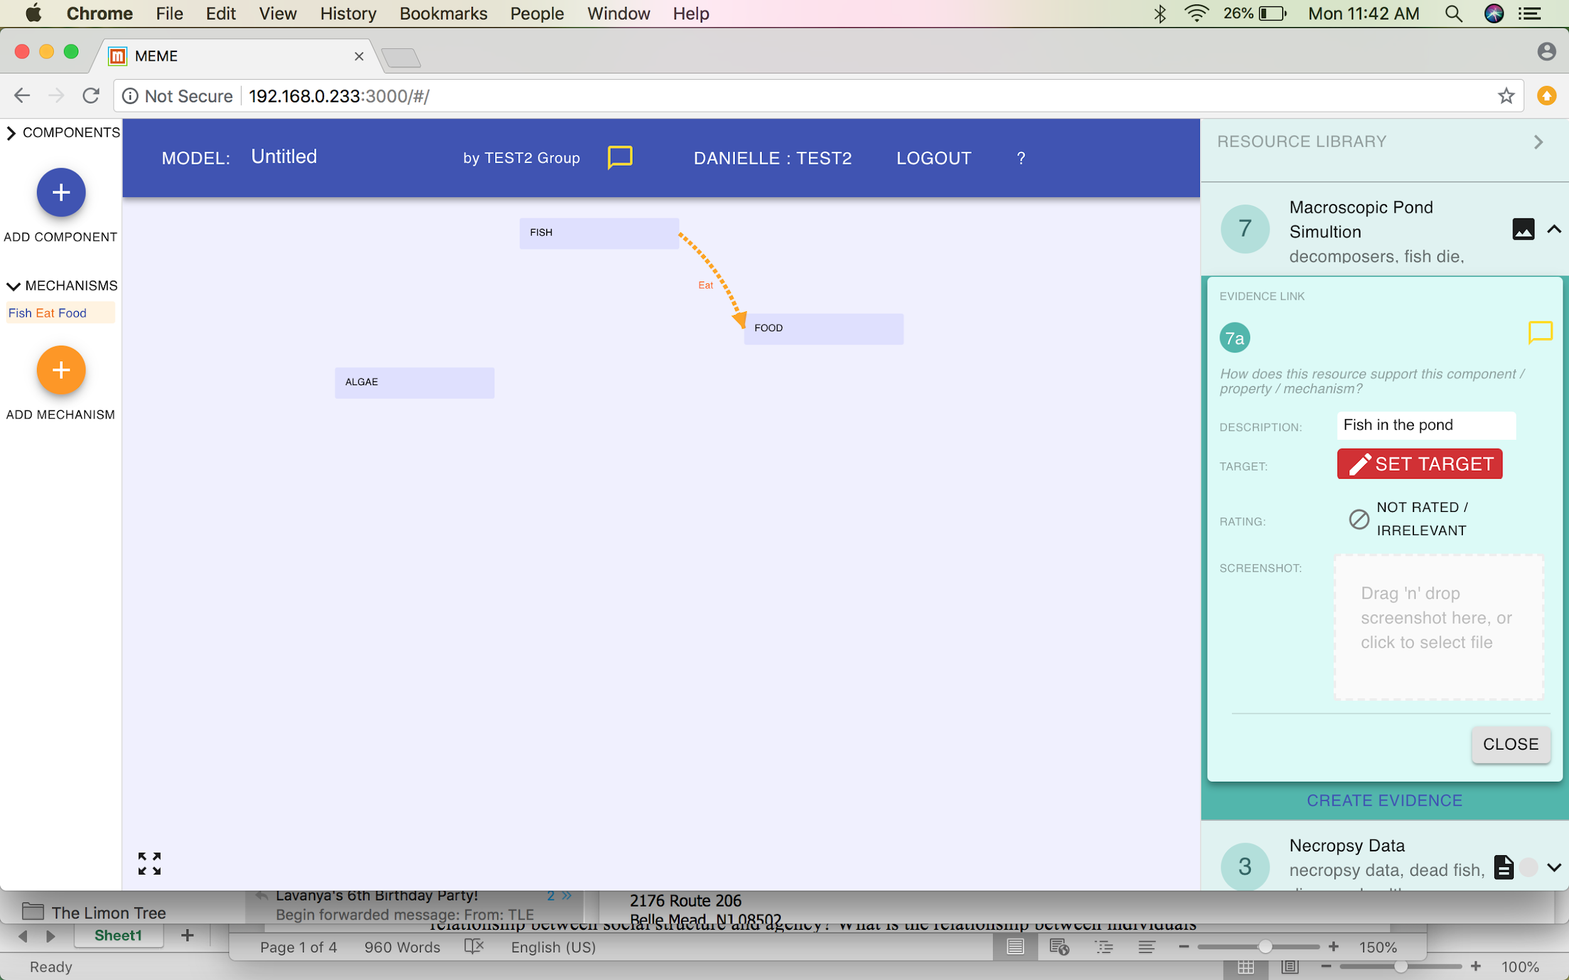
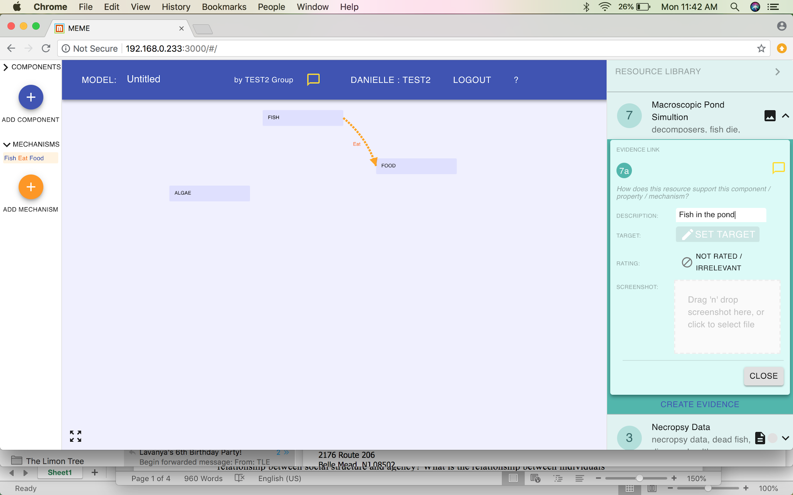
MEME: Link Evidence
Step 3: Name the
evidence. For
example, sim shows
fish in pond.
Step 4: Now we want to set target. Think: what does the evidence support? Click on “set target”
Notes:
Instruction
Now the screen looks like this. Step 3- Name the evidence. Remind students that it’s important to name the evidence in a way that tells then what the evidence is. If they name the evidence after football teams, they won’t remember which piece of evidence is which. They can name is something like “sim shows fish in pond.” This reminds them that this evidence shows that there are fish in the pond. Also, don’t make description too detailed or the name will be too long, and they won’t be able to read it.
Step 4- Click on set target. This means they link the evidence to a specific piece of the model. They can link it to a component or mechanism. Talk through what an appropriate target would be. For example, do I want to put a piece of evidence proving that there are fish in the pond on the air component? No because they are two separate things, and that piece of evidence is not connected to air. Therefore, students need to think through which piece of the model they are proving. Click on set target.

Slide 15
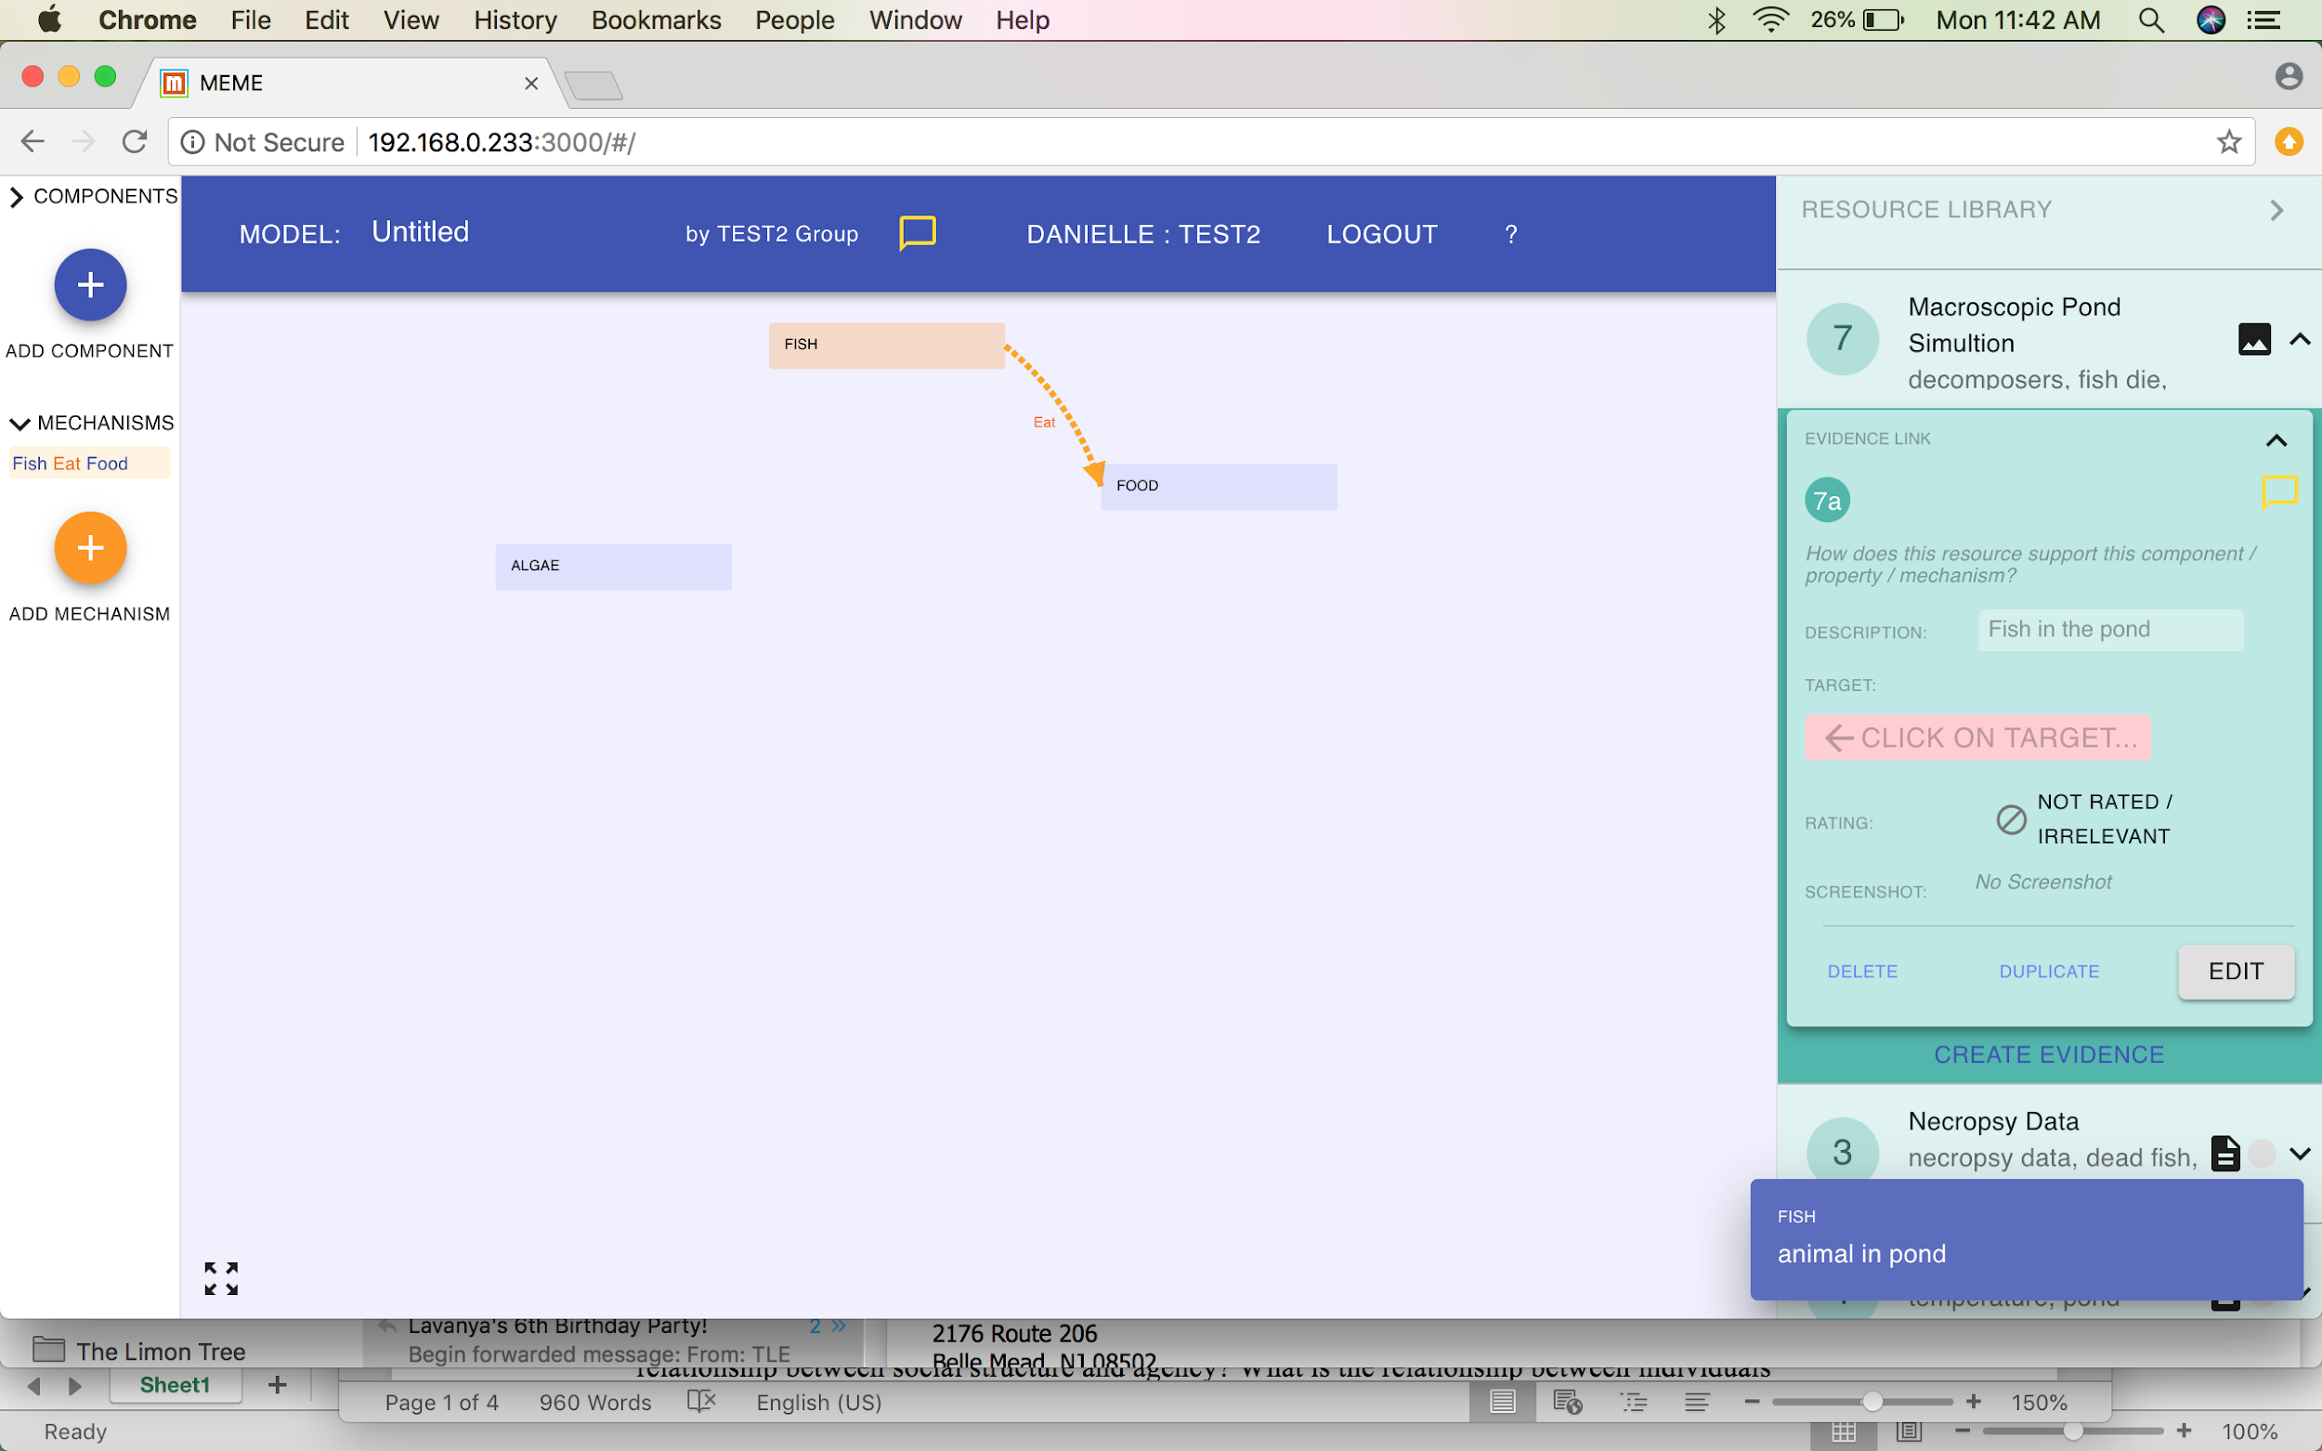
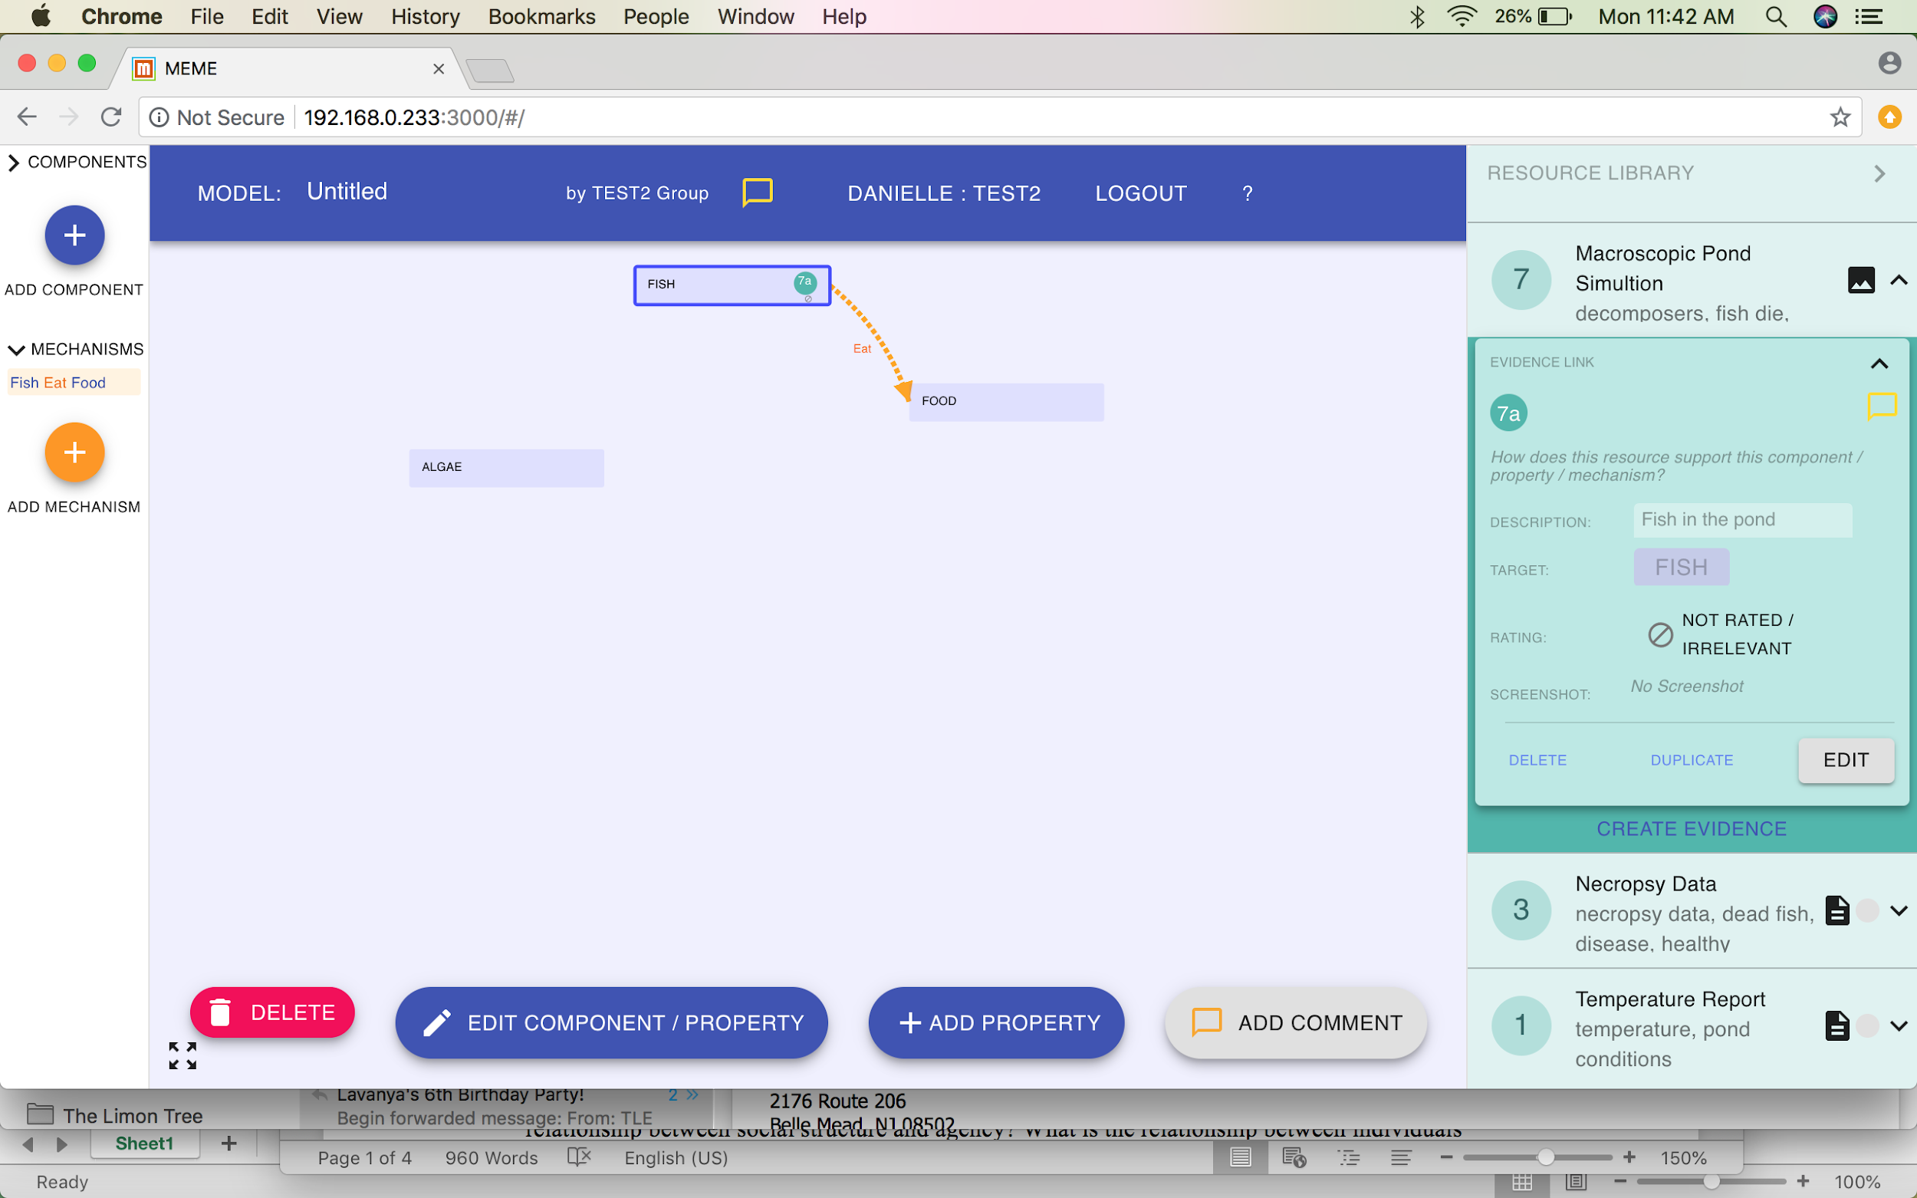
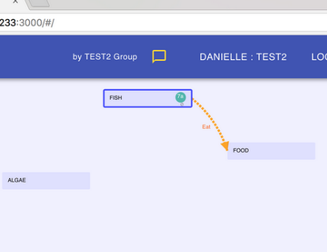
MEME: Link Evidence
Step 5: See the instruction
to “click on target”
Step 6: Select the target, which is a component or mechanism.
Now see the evidence number and
location in the green circle
Notes:
Instruction
Step 5- NOTICE how the “click on target” button is now showing in pink. This is telling students to select the target that they want. Remember, they want the target that the evidence directly relates to.
Step 6- click on the target. This is the piece of the model they want to support.
Step 7- this piece happens automatically. They will see a small green circle in the place where they put the evidence. Here, they can see that the evidence is on the fish component, therefore supporting that there are fish in the pond.
Explaining a bit more what this evidence link looks like- the evidence link (green circle) contains a number. The number means the order for which the evidence was input into MEME. If they click in the resource library, they will see the number next to the name of the evidence (which is why it’s important that the name describes what it is supposed to describe).
After these steps, they don’t need to do anything. The evidence automatically saves. They will think they need to click “ok” or something like that but they don’t. They can click the arrow up button on the top of the evidence box to minimize the evidence box.

